Slide 1
Deep reinforcement learning for autonomous driving in AWS Deep Racer

Slide 2
AWS Deep Racer

Slide 3
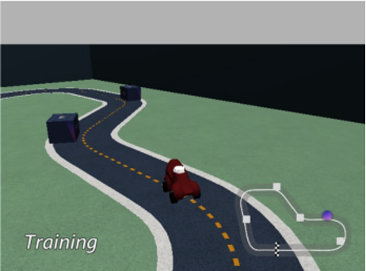
Objectives
Time trial
Obstacle avoidance
Fixed
Randomly placed
Head-to-head racing
Source: https://docs.aws.amazon.com/deepracer/

Slide 4
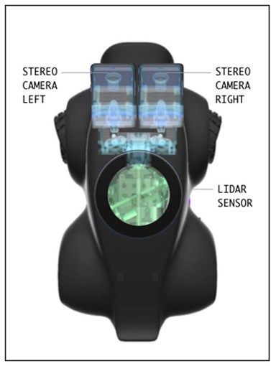
Sensors
Single camera
Stereo camera
+ Lidar
Source: https://docs.aws.amazon.com/deepracer/

Slide 5
Optimization algorithms
Proxima Policy Optimization (PPO)
Discrete/Continuous action spaces
Soft Actor-Critic (SAC)
Only continuous action space
Must better overcome local minima

Slide 6
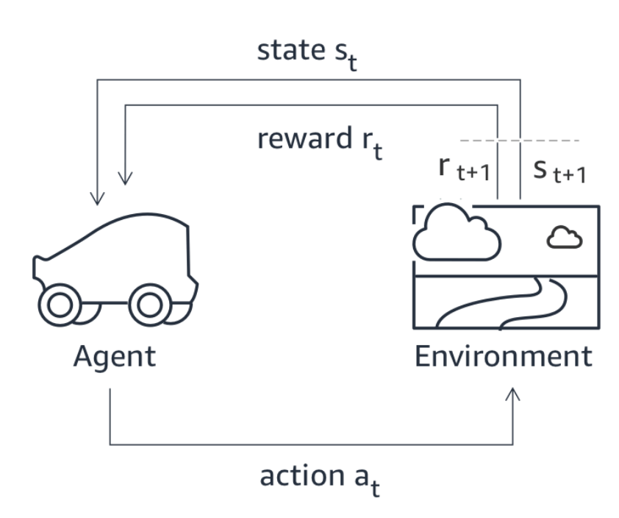
Reward function
Takes environment parameters as input
Car position on the road
Distance from the center
Distance to objects
…
Returns reward (0-∞)
Source: https://docs.aws.amazon.com/deepracer/

Slide 7
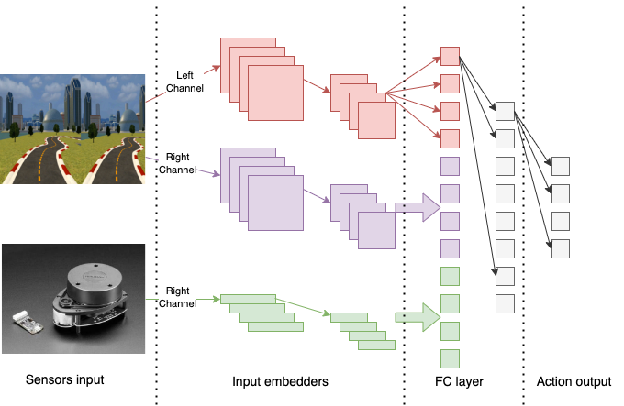
Policy network
Original image

Slide 8
Existing solutions

Slide 9
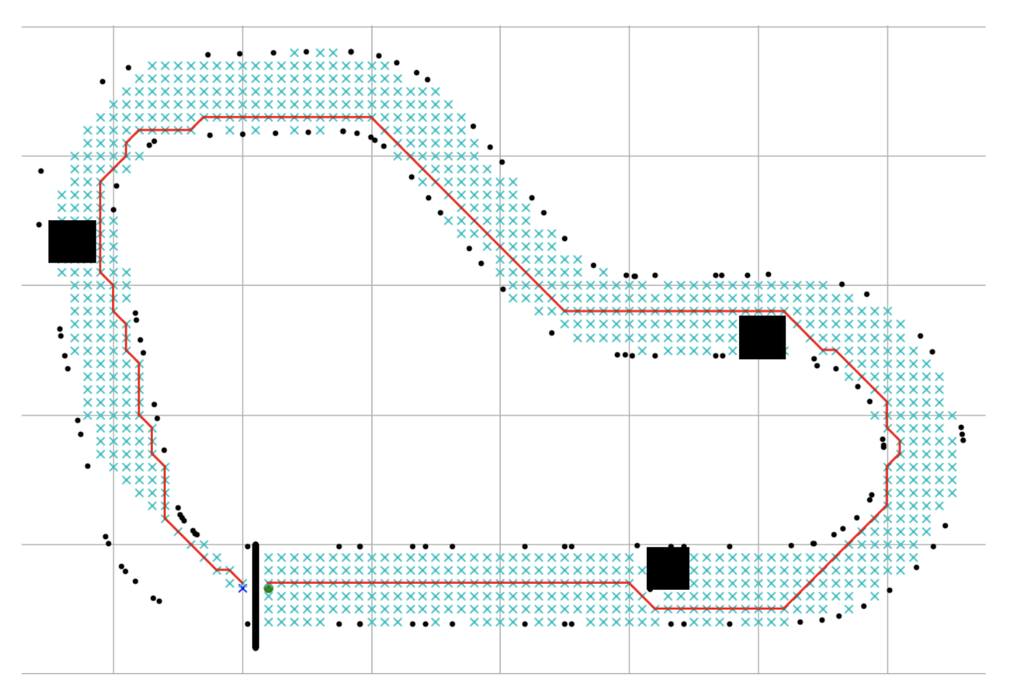
Existing solutions
There are not many scientific publications on this topic
Most of them are focusing on Time trial or Fixed obstacles avoidance
Many of the solutions don’t leverage the full power of RL

Slide 10
Experiments

Slide 11
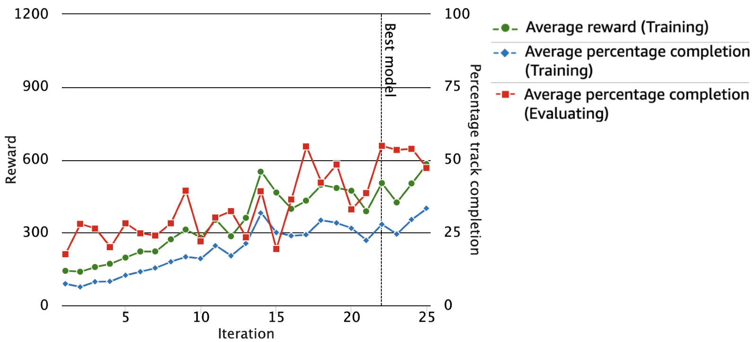
Baseline model
Example reward function
PPO
Stereo camera
Trial | Time (MM:SS.mmm) | Trial results | Off-track | Off-track penalty | Crashes | Crash penalty
1 | 03:17.583 | 100% | 0 | -- | 26 | 130 seconds
2 | 02:09.535 | 100% | 0 | -- | 16 | 80 seconds
3 | 01:04.011 | 100% | 0 | -- | 6 | 30 seconds

Slide 12
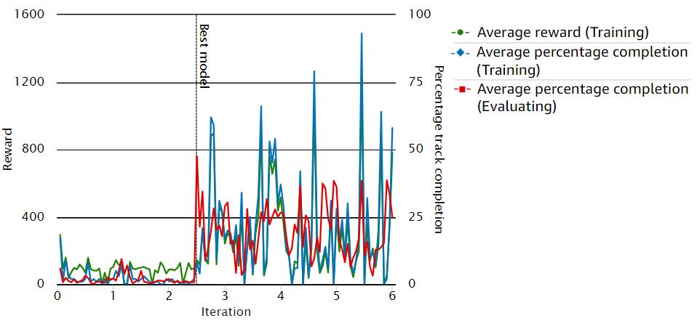
Baseline model with SAC
Example reward function
SAC
Stereo camera

Slide 13
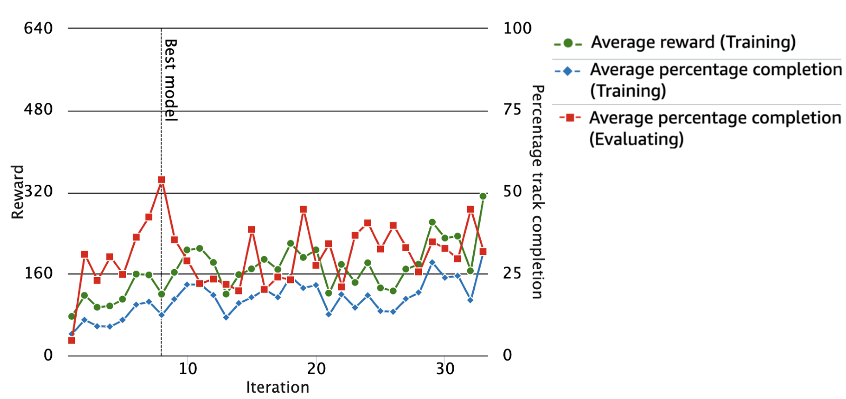
Reduced action space
Example reward function
PPO
Stereo camera
Reduced action space
No. | Steering angle (°) | Speed (m/s)
1 | -30.0 | 0.75
2 | -15.0 | 0.75
3 | 0.0 | 0.75
4 | 15.0 | 0.75
5 | 30.0 | 0.75

Slide 14
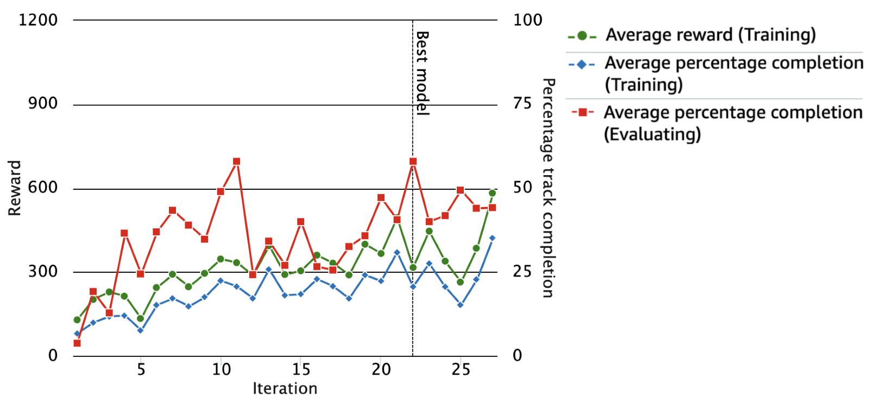
Extended baseline model
Extended reward function
Discourage agent from approaching obstacles from the side
PPO
Stereo camera
Trial | Time (MM:SS.mmm) | Trial results | Off-track | Off-track penalty | Crashes | Crash penalty
1 | 00:46.98 | 100% | 0 | -- | 4 | 20 seconds
2 | 01:02.74 | 100% | 1 | 2 seconds | 6 | 30 seconds
3 | 00:52.74 | 100% | 0 | -- | 5 | 25 seconds

Slide 15
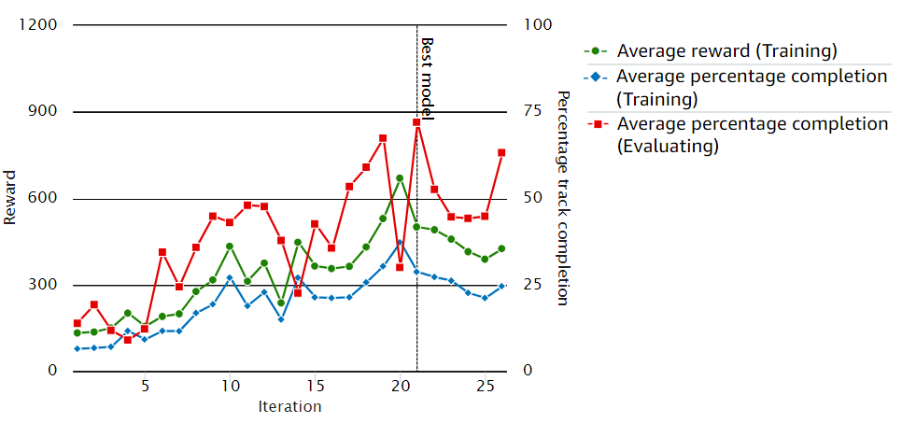
Extended baseline model with Lidar
Extended reward function
PPO
Singe camera + Lidar
Trial | Time (MM:SS.mmm) | Trial results | Off-track | Off-track penalty | Crashes | Crash penalty
1 | 00:51.988 | 100% | 0 | -- | 4 | 20 seconds
2 | 00:29.824 | 100% | 0 | -- | 1 | 5 seconds
3 | 01:04.653 | 100% | 1 | 2 seconds | 5 | 25 seconds

Slide 16
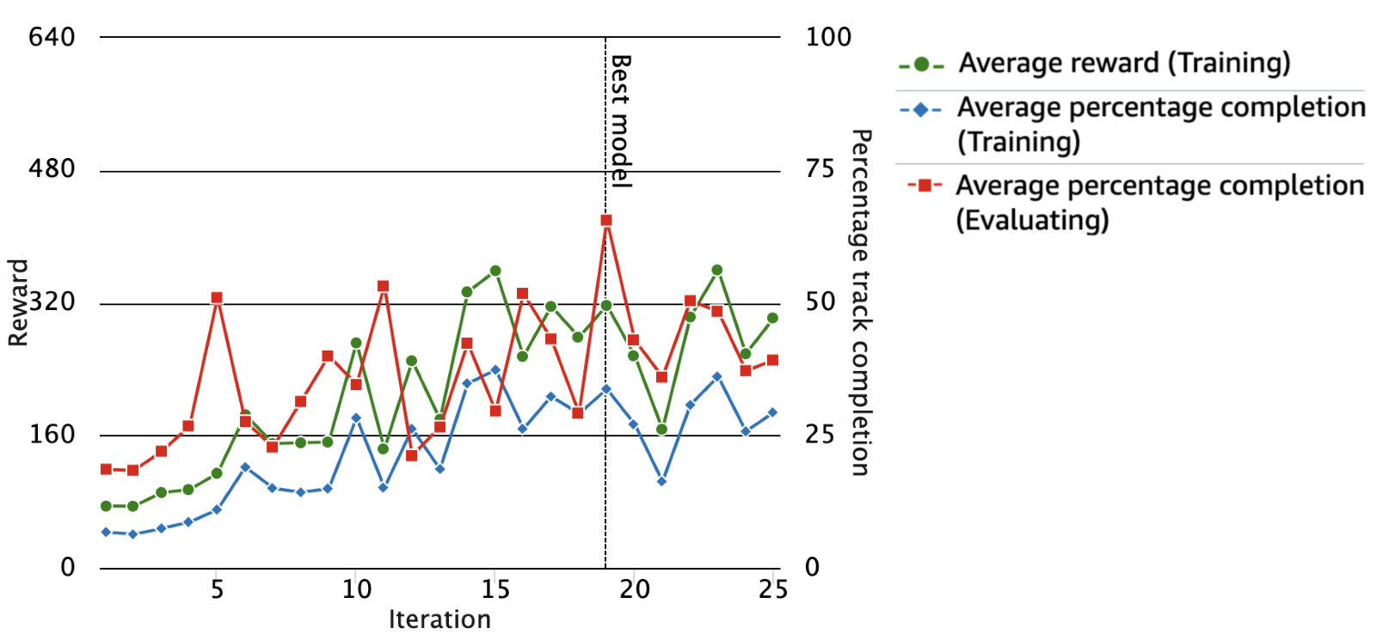
Continuous reward function
Continuous reward function
Returns continuous rewards
Differentiable
PPO
Stereo camera
Trial | Time (MM:SS.mmm) | Trial results | Off-track | Off-track penalty | Crashes | Crash penalty
1 | 01:12.190 | 100% | 0 | -- | 8 | 40 seconds
2 | 00:46.606 | 100% | 0 | -- | 4 | 20 seconds
3 | 00:47.126 | 100% | 1 | 2 seconds | 4 | 20 seconds

Slide 17
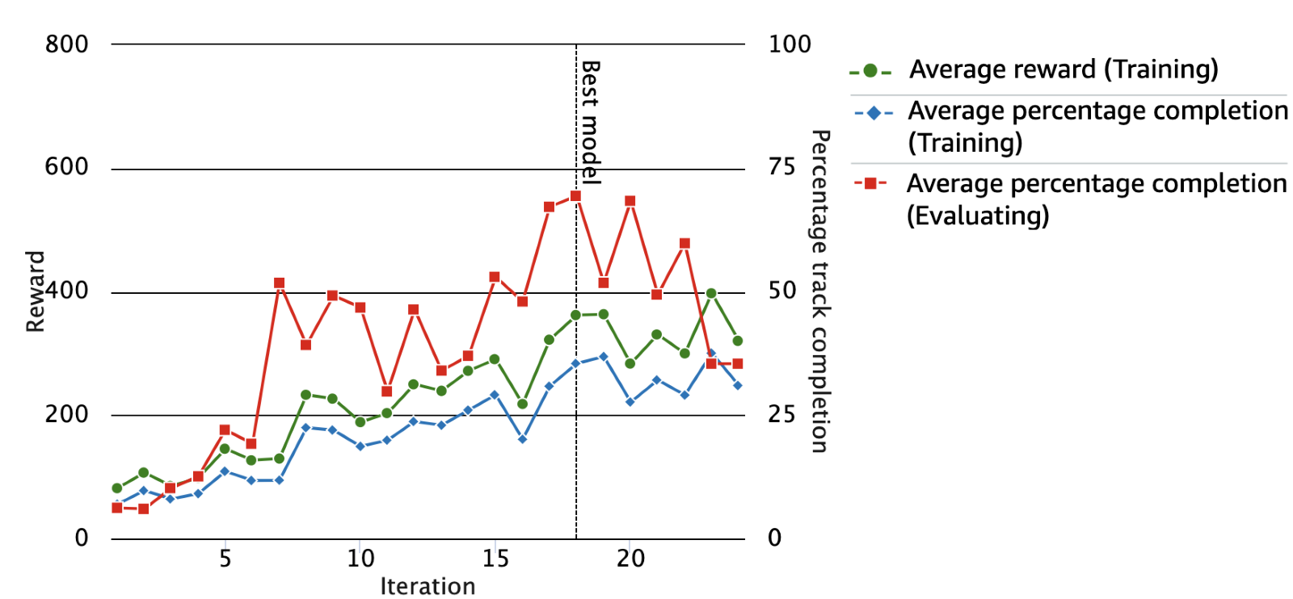
Continuous reward function with Lidar
Continuous reward function
PPO
Singe camera + Lidar
Trial | Time (MM:SS.mmm) | Trial results | Off-track | Off-track penalty | Crashes | Crash penalty
1 | 00:22.857 | 100% | 0 | -- | 0 | --
2 | 00:29.673 | 100% | 0 | -- | 1 | 5 seconds
3 | 00:30.285 | 100% | 1 | -- | 1 | 5 seconds

Slide 18
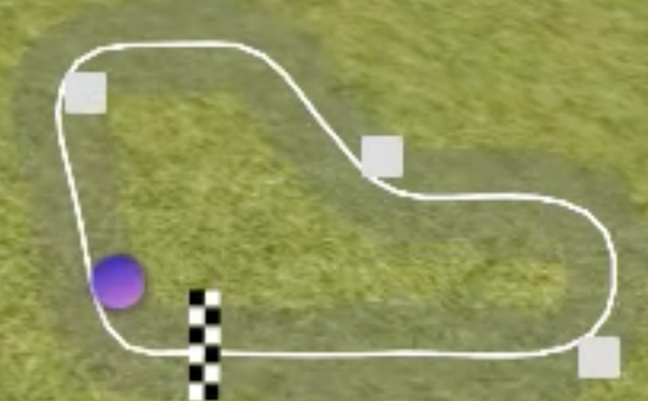
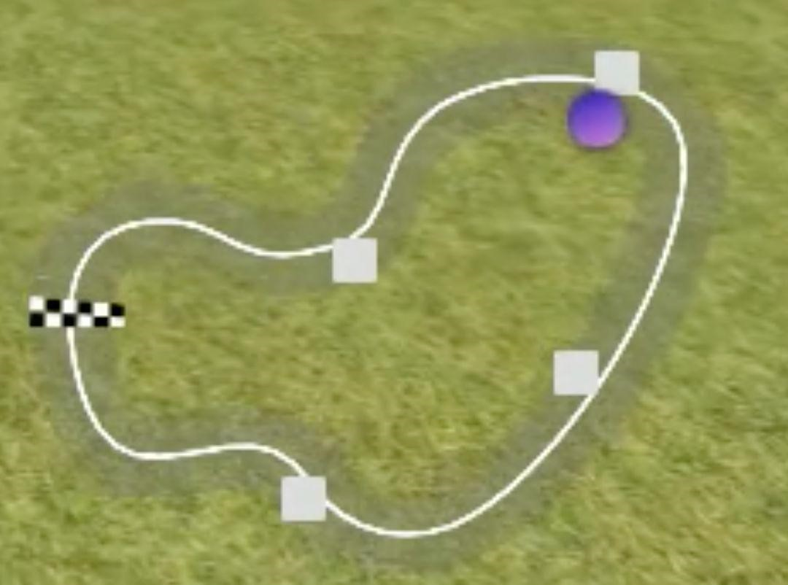
Unknown environment
Trial | Time (MM:SS.mmm) | Trial results | Off-track | Off-track penalty | Crashes | Crash penalty
1 | 00:53.292 | 100% | 1 | 2 seconds | 3 | 15 seconds
2 | 00:27.494 | 100% | 2 | 4 seconds | 0 | --
3 | 00:39.144 | 100% | 2 | 4 seconds | 0 | --

Slide 19
Comparison
Experiment Name | Total Crashes | Total Off-track | Total Time | Laps without Crashes
Baseline | 48 | 0 | 06:31.129 | 0
Extended Baseline | 15 | 1 | 02:40.256 | 0
Extended Baseline with LIDAR | 10 | 1 | 02:26.465 | 0
Continuous Reward | 16 | 1 | 02:45.922 | 0
Continuous Reward with LIDAR | 2 (⬇️95.8%) | 0 | 01:22.815 (⬇️78.9%) | 1
Continuous Reward with LIDAR, unknown environment | 3 | 5 | 01:59.930 | 2

Slide 20
Publication

Slide 21
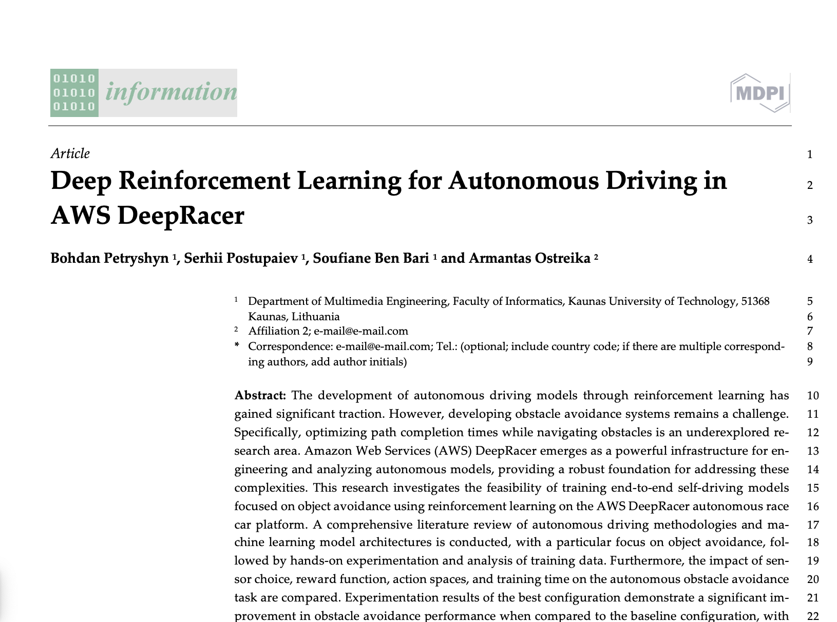
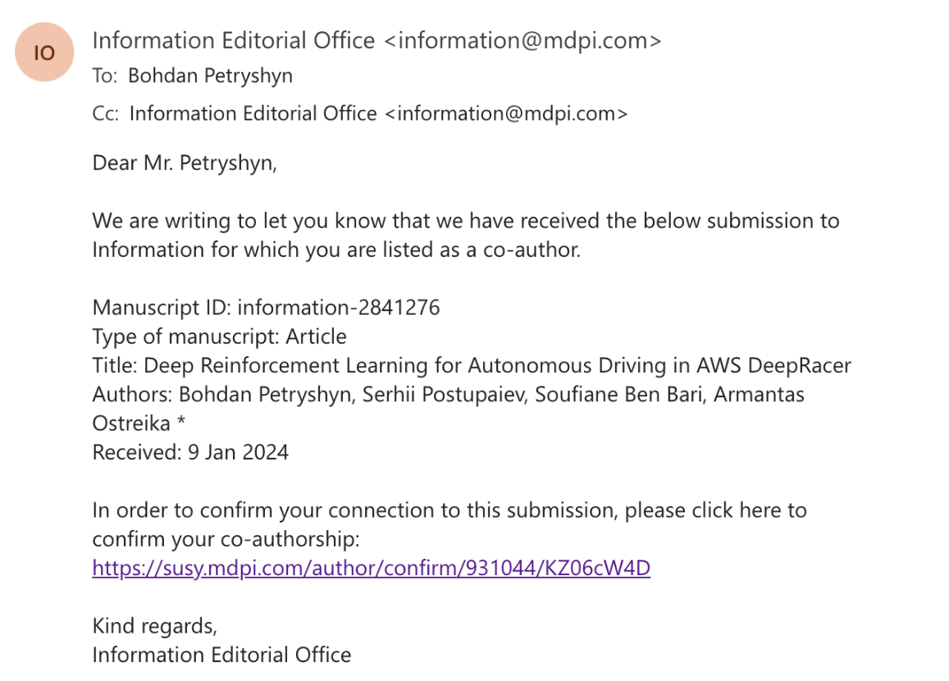

Slide 22
Questions?

